Slide 1

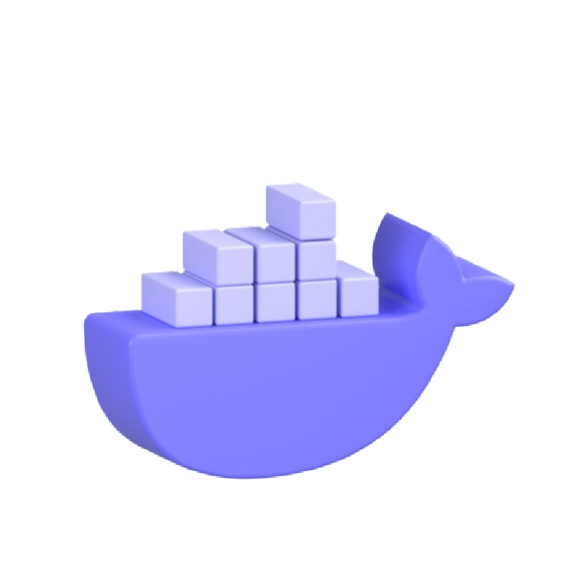
20 ESSENTIAL
DOCKER
COMMANDS

Slide 2


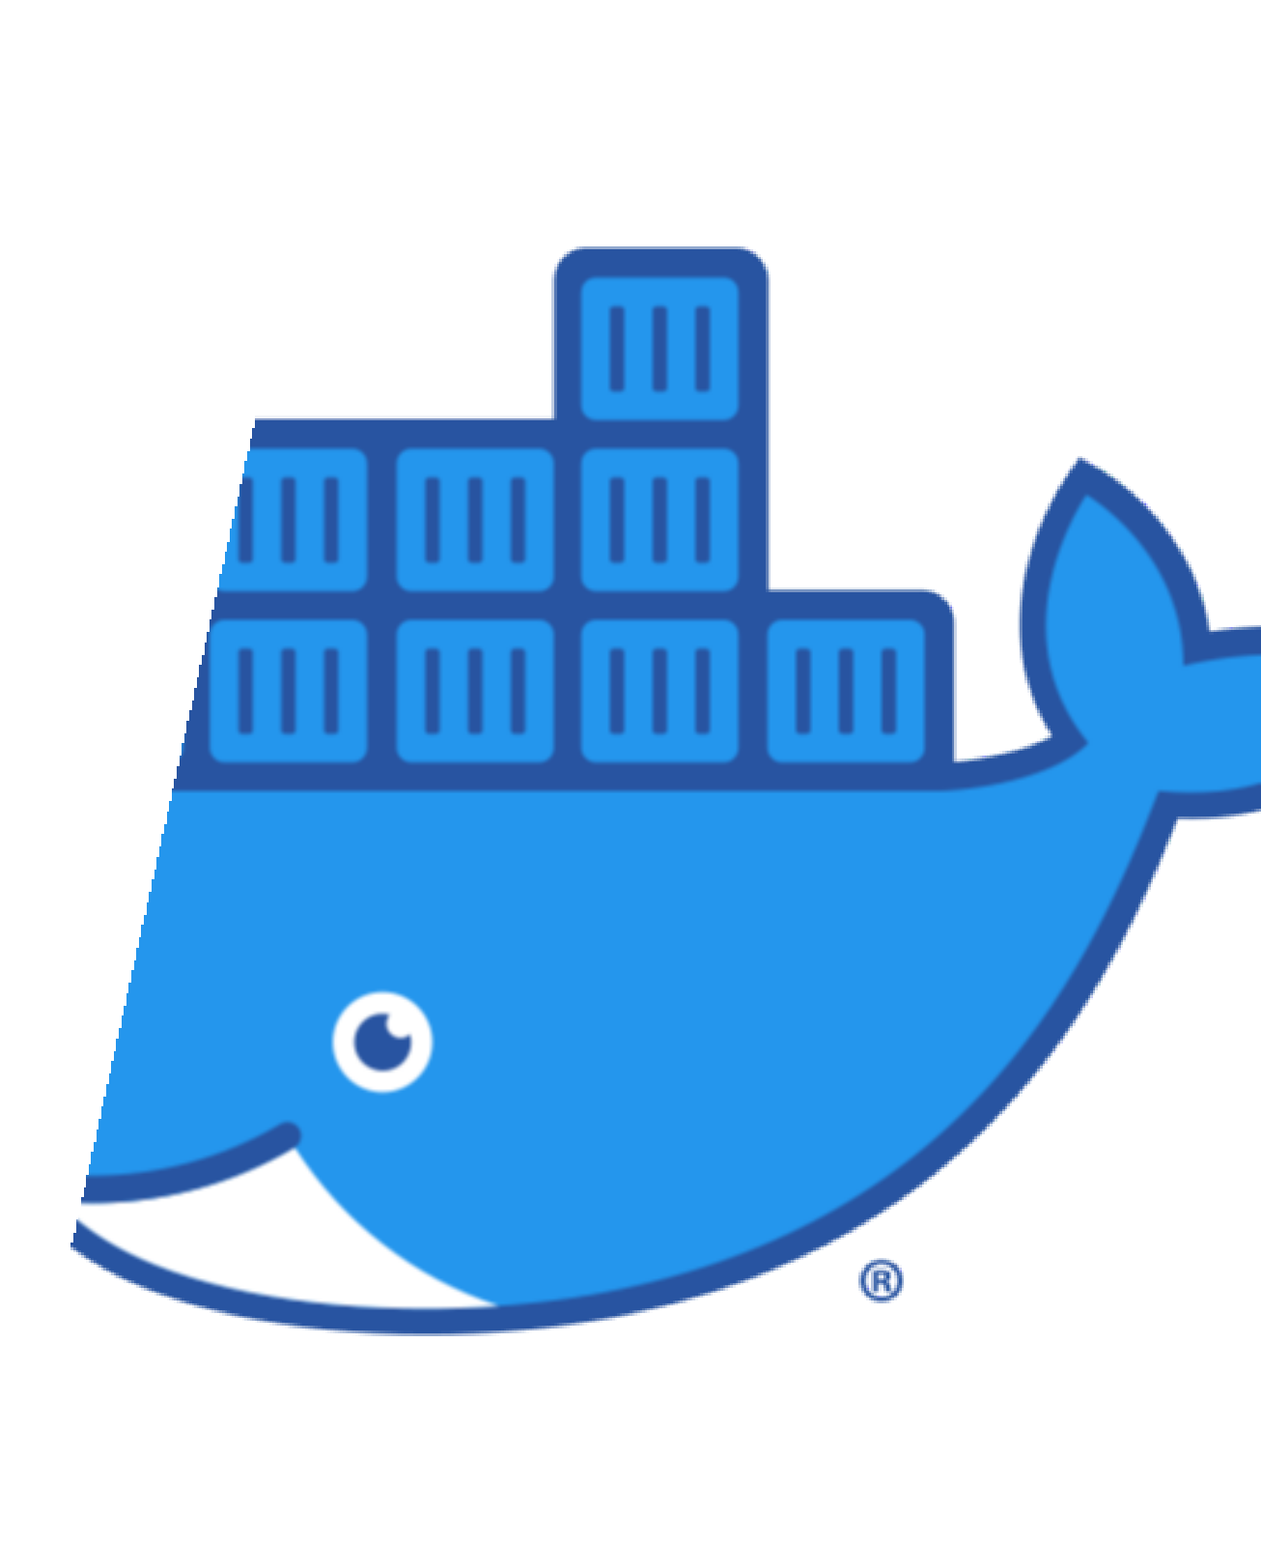


INTRODUCTION
Docker has revolutionized the way we develop, deploy, and manage applications. Its containerization technology allows developers to package applications and their dependencies into a single unit, ensuring consistency across different environments. Whether you're new to Docker or a seasoned developer, mastering essential Docker commands is crucial for efficient container management. In this article, we'll explore 20 Docker commands that every developer should know.

Slide 3
docker --version:
The first step in working with Docker is to ensure you have it installed. Running docker --version will display the installed Docker version, confirming that everything is set up correctly.

Slide 4
docker info:
For a comprehensive overview of your Docker installation, utilize docker info. This command provides valuable information about system resources, storage, networking, and more.

Slide 5
docker pull :
Before running containers, you need to download the necessary Docker images from a registry like Docker Hub. Use docker pull to fetch an image and make it available on your system.
Example : docker pull nginx

Slide 6
docker build -t .:
Creating custom Docker images is common practice.
The docker build command with the -t flag lets you build an image from a Dockerfile located in the current directory and assigns it a meaningful tag.

Slide 7
docker images:
To view all the Docker images available on your system, simply execute docker images. This command provides a list of images, their tags, creation dates, and sizes.

Slide 8
docker run :
The docker run command is fundamental for starting containers. By providing the desired image name, you can create and launch a new container instance.
Example : docker run -d --name mynginx -p 8080:80 nginx

Slide 9
docker ps:
To check the running containers on your system, use docker ps. This command displays a list of containers along with their IDs, names, and statuses.

Slide 10
docker ps -a:
For an overview of all containers, including those that have stopped running, run docker ps -a. This is useful for inspecting the history of your containers.

Slide 11
docker start :
To start a stopped container, use docker start . This command resumes the container's execution from the point where it was paused.
docker start f4c3b1d29e79

Slide 12
docker stop :
Stopping a running container is achieved with docker stop . This command gracefully terminates the container's processes.
docker stop f4c3b1d29e79

Slide 13
docker restart :
Sometimes, you may need to restart a container to apply changes or reset its state. The docker restart command accomplishes this.
docker restart f4c3b1d29e79

Slide 14
docker rm :
Once a container is no longer required, you can remove it using docker rm . This frees up resources and helps keep your system clean.
docker rm <container id>

Slide 15
docker rmi :
When an image is no longer needed, you can delete it with docker rmi . However, ensure that no containers are based on that image before removal.
docker rmi <image-id>

Slide 16
docker exec -it :
To execute a command interactively within a running container, use docker exec -it . This is valuable for troubleshooting and debugging purposes.
docker exec -it bash <container id>

Slide 17
docker logs :
Accessing a container's logs is essential for understanding its behavior and identifying potential issues. Employ docker logs to view the container's log output.
docker logs <conatiner-id> docker logs -f <container-id>

Slide 18
docker cp :
Copying files or directories between the host and a container is straightforward with docker cp. This command helps in moving data in and out of containers.
docker cp /path/to/localfile.txt mycontainer:/path/to/

Slide 19
docker network ls:
Docker networks facilitate communication between containers. Use docker network ls to see a list of networks available on your system.

Slide 20
docker volume ls:
Docker volumes are used to persist data beyond the container's lifecycle. docker volume ls allows you to see a list of volumes available on your system.

Slide 21
docker-compose up:
For multi-container applications, Docker Compose is an invaluable tool. docker-compose up starts all services defined in the docker-compose.yml file.

Slide 22
docker-compose down:
When you want to stop and remove containers, networks, and volumes defined in the docker- compose.yml file, use docker-compose down.

